Slide 1
For Payment related issue we have came up with new solutions in the month of August 2021.

Slide 2
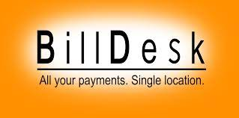
1). ICICI Bank real time payment match with virtual Account Number
2). Bill Desk payment.

Slide 3
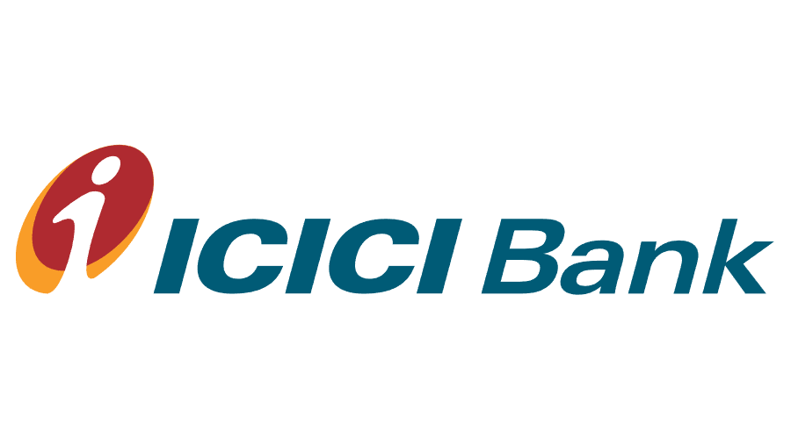
1). ICICI Bank real time payment match with virtual Account Number
If the Virtual Account number not matched with the challan amount the bank will refund the amount to the origin account after 30 mints.

Slide 4
Credit and Debit Cards. Accept payments from any bank credit/debit card or network cards in India.
UPI
Net Banking.
QR code scanning and other wallet. payments

Slide 5
The status showing as pending:
Ans: If the transaction status showing as pending the said transaction will modified after 3 days and then the DA allowed to do the payment.
2) Transaction failure/Reject.
Ans: The DA opened the payment gateway and fail to complete the transaction due to any reason then the transaction status will come as reject/Failure. After 30 to 45 minutes the DA can generate another challan and complete the transaction.
3 ) What if the DA entered wrong PIN/Password.
Ans: As the DA entered the wrong PIN/Password as the transaction already initiated this transaction will be consider as fail/reject. Hence the DA needs to generate another challan.

Slide 6
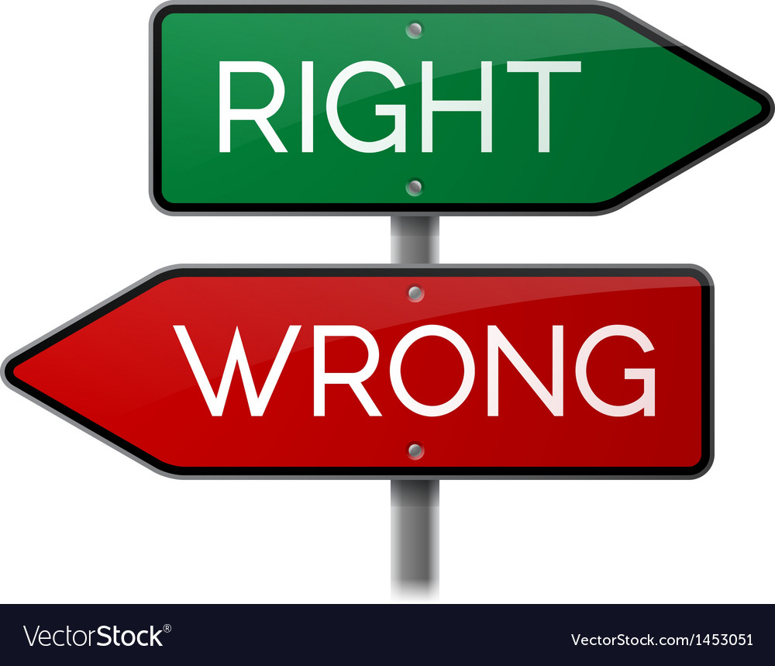
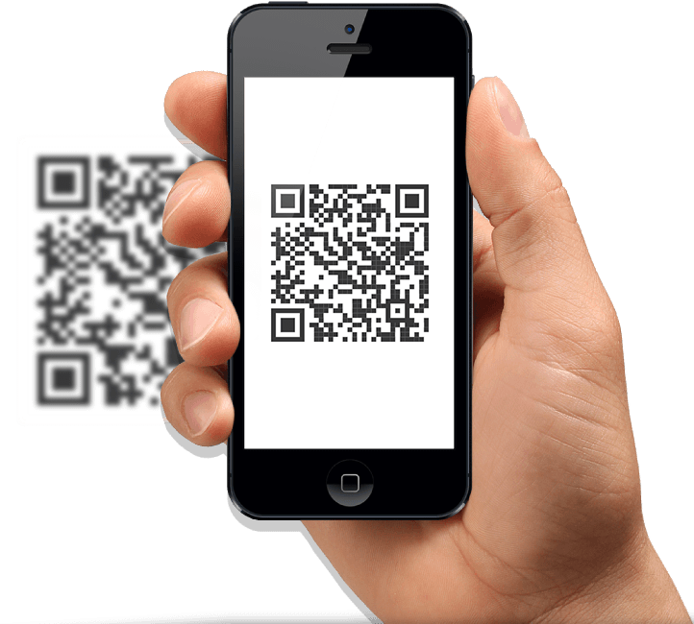
The most of the DA’s carrying the print of out the QR code please stop this practice.

Slide 7
For ICICI challan issues we have come up with new screen in the DA login were the DA can update the problematic challans. The challans available from the inception i.e March ,2021.

Slide 8
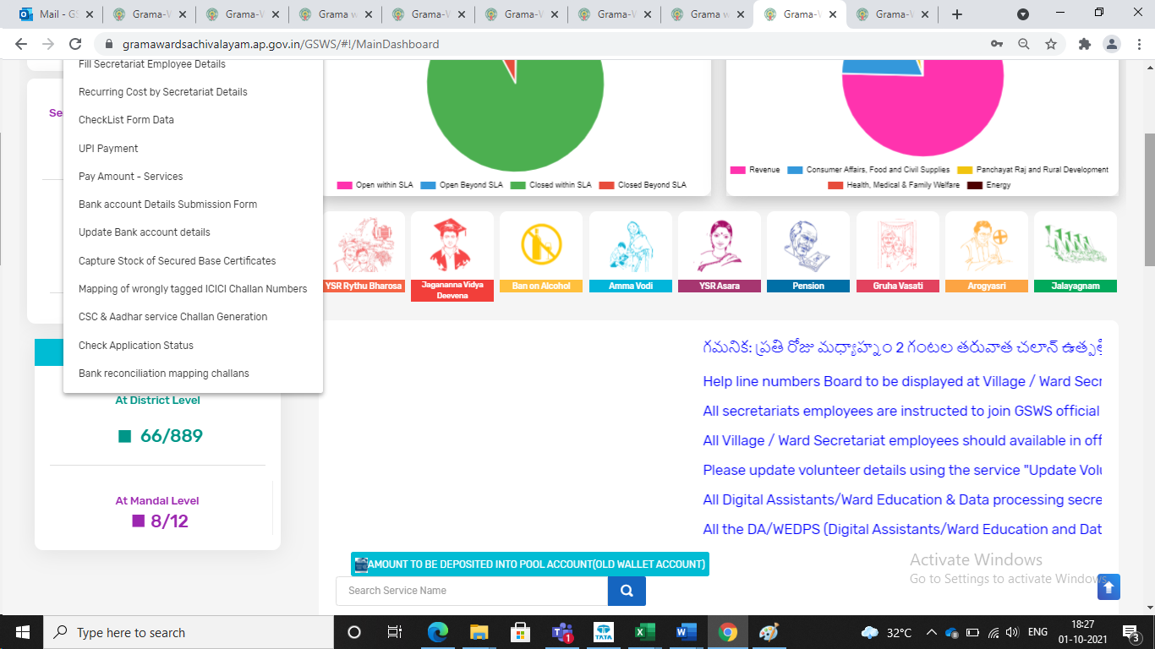
Home Services Bank Reconciliation mapping challans.

Slide 9
